Slide 1
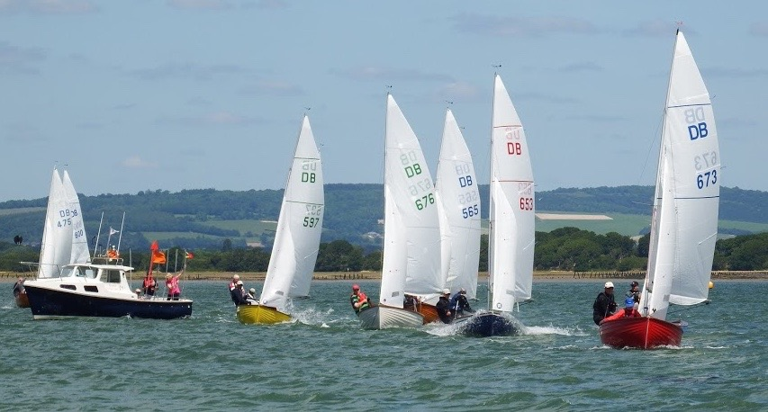
BOSHAM YACHTING WORLD DAYBOAT OPEN MEETING
SA
SATURDAY 15th May 2021
2 RACES (Both to count)
1st Race 12.10pm, 2nd race back to back. Tea and prizegiving
FOR DETAILS EMAIL DAVID MACFARLANE: DAVIDMAC100@GMAIL.COM

